Slide 1
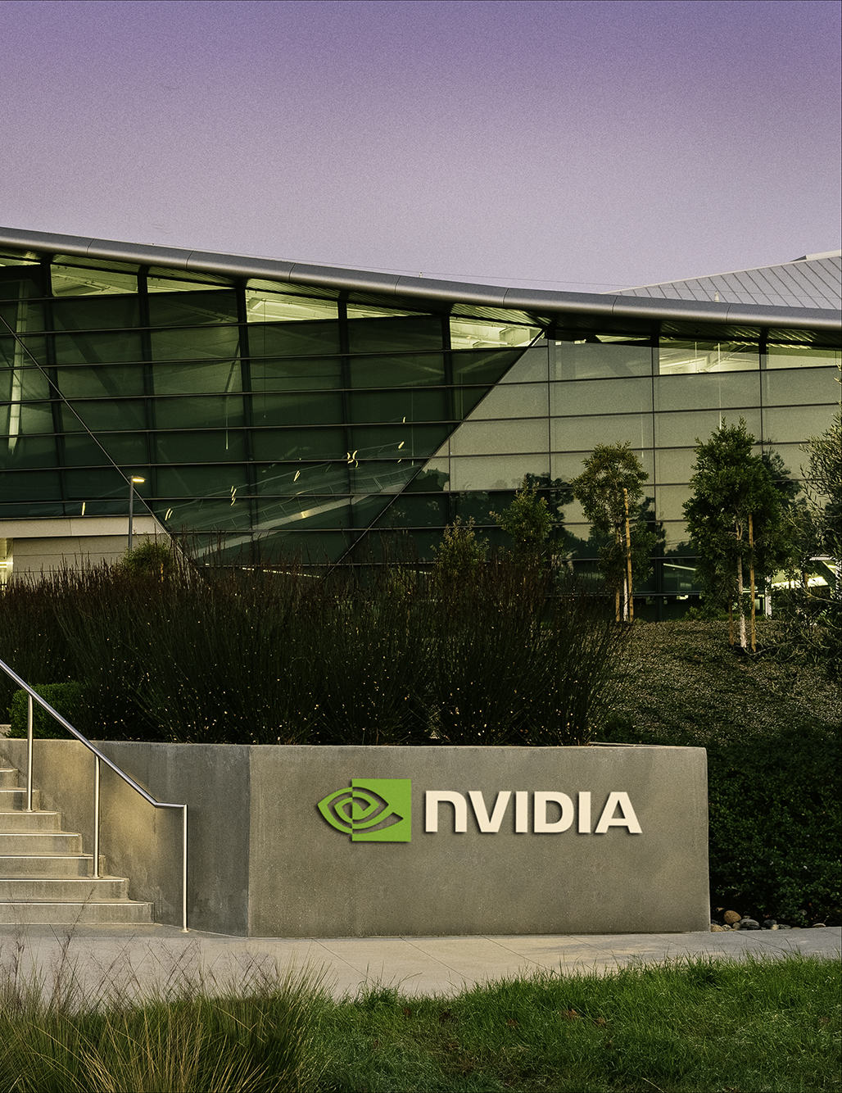
In-Depth Analysis of Nvidia Corporation’s Success
By:
Mazen Alhaffar
Jun Ming Li
Neha Chowke
By:
Mazen Alhaffar
Jun Ming Li
Neha Chowke
Notes:
Founded in 1993 by Jensen Huang, Chris Malachowsky, and Curtis Priem, and headquartered in Santa Clara, California, Nvidia

Slide 2
About the company
Industry giant in gaming, AI, chip manufacturing, and data services
1
Strategic partnerships with Microsoft, Amazon, Google, AMD, Microsoft and Lenovo
4
Large global potential market growth for their products and services
2
GPU was responsible for the NASA flight and Covid-19 spread simulations
3
Notes:
Pioneering GPU, continues to develop platforms to help enhance physical AI and simulations

Slide 3
executive summary
Largest GPU producer with 90% market share
Diverse revenue streams across multiple industries and countries
78% of revenue is derived from data center revenue which increased by 2x in 2024
$61 Billion in sales in 2024
Ranked 1st in Forbes best companies
Competitive Advantage
Notes:
Pioneering GPU, continues to develop platforms to help enhance physical AI and simulations

Slide 4
executive summary
Market Profile (Jan-24)
Closing Price (01/31/2024) | $61.53
52 Week High / Low | $61.53 / $19.54
Stock Return (Y to Y) | 2.15x
Average Volume (1 Year) | 463,205,211
Market Cap | $1.5T
Dividend Yield | 0.03%
Dividend Payout Ratio | 1.3%
EV / Revenue | 17.1x
EV / EBITDA | 30.9x
Since 2023, Nvidia’s stock has outpaced the Nasdaq-100 Index, reflecting exceptional growth and positioning the company for promising long-term returns.

Slide 5
executive summary
Nvidia’s stock performance has consistently outpaced its competitors and the broader industry, particularly demonstrating significant growth compared to the Nasdaq-100, Broadcom, Qualcomm, Intel, and AMD since mid-2021.

Slide 6
Competitive Position – porter’s v forces
Threat of New Entrants: Nvidia's strong market position, high capital requirements, strategic partnerships, and economies of scale make it difficult for new competitors to enter the market.
Bargaining Power of Suppliers: Nvidia's reliance on a limited number of suppliers for key components gives suppliers moderate power, though Nvidia's financial strength offer flexibility.
Bargaining Power of Buyers: While Nvidia's products are critical for large-scale operations, its customers have some bargaining power due to the potential for switching suppliers.
Threat of Substitutes: The rise of in-house AI chips from major tech companies and potential disruptive technologies like quantum computing increases the threat of substitutes to Nvidia's products.
Threat of Competitive Rivalry: Nvidia faces high competitive pressure from established players like Intel and AMD, but strategic acquisitions and innovations help it maintain a strong market position.

Slide 7




Competitive Position - SWOT
Pioneer
Exceptional Quality
Widespread Use
Continue Innovation
AI Legislation
Supply chain disruptions
Emerging competitors like Deepseek
Reliance on foreign foundries and materials
Global revenue mainly from China and Taiwan
Growing competitors
Partnerships with Toyota, Auroa, Continental
Continued acquisitions
Created platforms to utilize Physical AI and simulations
Notes:
Pioneered the GPU and since then, it has become a paragon for what it means provide exceptional quality products and services, especially in the gaming sphere. Moreover, this computational process has also been recognize in fields outside of just game and their products have been used for heavy computational analysis. Their continued innovations and emphasis on RD has lead to continued AI development, as demonstrated by their platforms for physical AI and simulations. Compute Unified Device Architecture) is a parallel computing platform that allows developers to use GPUs for general computing.

Slide 8

Financial Analysis - Growth
In 2024, Nvidia's revenue surged by 126%, driven by its dominance in GPUs and AI chips, leading to an impressive 581% increase in net income from 2023. Despite rising costs, Nvidia effectively managed indirect expenses while experiencing a 43% increase in direct costs, aligning with its exceptional revenue growth.
Notes:
I’m going to go over Nvidia’s financial analysis.
Nvidia experienced exceptional financial growth in 2024, with a 126% surge in revenue fueled by its dominance in GPUs and AI chips.
This led to a 581% increase in net income from 2023, reflecting strong profitability.
The company effectively managed indirect expenses while direct costs increased by 43%, aligning with its revenue expansion.
As you can see in the left chart, it shows a steady rise in total revenue and net income from 2015 up to 2022, with a significant spike in 2024, indicating accelerated growth.
And the right chart, highlights the breakdown of direct and indirect costs in 2024, demonstrating cost efficiency despite rising expenses.
Nvidia's financial strategy enabled sustainable expansion, reinforcing its market leadership and innovation-driven success.

Slide 9

Financial Analysis - Profitability
Nvidia has consistently expanded its profit margins, demonstrating strong cost management and operational efficiency, even recovering from 2023’s volatility to surpass its 2022 performance records. Despite pandemic-related setbacks in 2020-2021 and legal challenges in 2023, Nvidia rebounded in 2024, achieving explosive growth through innovation and market leadership.
Notes:
Nvidia has demonstrated consistent profitability growth, with record-breaking margins in 2024 due to strong cost management and operational efficiency.
The Gross Profit Margin remained high, while Operating and Net Profit Margins showed steady improvement, reflecting increased profitability.
The company experienced a sharp rise in Return on Assets (ROA), Return on Equity (ROE), and Return on Investment (ROI) in 2024, indicating enhanced returns on investments.
Despite pandemic-related setbacks (2020-2021) and legal challenges in 2023,
Nvidia rebounded strongly, surpassing its 2022 performance records.
This explosive growth was driven by innovation, market leadership, and strategic financial management, solidifying its dominance in the AI and GPU sectors.

Slide 10

Financial Analysis – DuPont Analysis
Nvidia has strategically increased leverage over the past five years, except in 2024, when asset growth outpaced equity, reflecting its use of debt to expand operations. Despite the higher financial risk, Nvidia's strong asset efficiency and improved profitability in 2024, driven by higher margins and revenue growth, have reinforced its market strength.
Notes:
Nvidia strategically increased leverage over the past five years, using debt to finance expansion, except in 2024, when asset growth outpaced equity.
The left chart shows fluctuations in long-term and total debt-to-equity ratios, with a decline in 2024, suggesting a shift towards asset-driven growth.
The right chart presents DuPont Analysis, highlighting improvements in profit margin (colored in yellow), total asset turnover (blue), and equity multiplier(Green), all contributing to strong financial performance.
In 2024, profitability surged (the yellow line in the graph), driven by higher margins and revenue growth, reinforcing Nvidia’s market strength despite increased financial risk.
This trend reflects efficient asset utilization and a solid return on equity strategy.

Slide 11
Company Valuation – valuation ratios
Nvidia has maintained strong investor confidence, with consistent growth in book value and earnings per share, reflecting effective management and financial health.
The P/BV ratio indicates that Nvidia’s market value surpasses its book value, highlighting investor confidence in its intangible assets, including its brand and intellectual property.
While the P/E ratio suggests Nvidia's stock may be overvalued, the P/CF ratio shows investors are willing to pay a premium, driven by expectations of strong future growth and profitability.
Notes:
Nvidia has maintained strong investor confidence, with consistent growth in book value (BV) and earnings per share (EPS), reflecting effective financial management.
The Price-to-Book Value (P/BV) ratio indicates that Nvidia’s market value exceeds its book value, showing that investors value its intangible assets, such as its brand and intellectual property.
The Valuation Ratios chart highlights a significant increase in Price to Book Value and Price-to-Cash-Flow (P/CF) ratios, suggesting investors are willing to pay a premium based on expectations of strong future growth and profitability.
However, the Price-to-Earnings (P/E) ratio suggests the stock may be overvalued, indicating high market optimism and potential risks associated with future earnings expectations.

Slide 12

Industry Analysis– revenue market share
As of 2023, Nvidia leads the semiconductor industry with a 27% revenue market share, closely followed by Intel and Broadcom, indicating fierce competition and a dynamic market.

Slide 13

Industry Analysis – liquidity measures
Nvidia’s current ratio is below the industry average, suggesting insufficient assets to cover short-term liabilities, while its declining cash reserves and slower accounts receivable collection indicate a weakening liquidity position and reliance on debt.

Slide 14

Industry Analysis – profitability measures
Nvidia’s underperformance in Return on Assets (ROA) and Return on Equity (ROE) compared to industry competitors raises concerns about profitability and operational efficiency, but its strong operating income margin and improving net income margin, especially in 2023, demonstrate effective scaling and cost management, likely driven by its leadership in AI and GPU markets.

Slide 15

Industry Analysis – asset quality measures
Nvidia’s higher Total Asset Turnover (TAT) compared to its peers reflects strong efficiency in generating revenue per dollar of assets, but its slower inventory turnover and higher Days Inventory highlight inefficiencies in product management, potentially hindered by pricing strategies and reliance on a few semiconductor factories.

Slide 16
Company Valuation – dcf model
A discounted cash flow analysis was used to determine Nvidia's intrinsic stock value, projecting a price of $42.88, based on a 5-year forecast and adjusted for the volatility and market sensitivity.
The WACC of 8.14% was calculated by averaging the total stock return of the historical and most recent year, reflecting Nvidia's significant growth in 2023, and the perpetual growth rate of 3% was set in line with the projected inflation rate by FRED.
While the projected price of $42.88 indicates that Nvidia's stock may be overvalued at $61.53 in 2024, the current market price is supported by the growing importance of AI technology, Nvidia's role in supporting major competitors, and its expected continued growth in the tech sector.
Nvidia’s financial projections indicate strong operational growth and an efficient investment strategy. The company is expected to experience high operating cash flow growth, enabling it to sustain heavy capital investments in the near term while ensuring positive free cash flow over time. This suggests a financially stable and growth-oriented company that is strengthening its market position while maintaining liquidity.

Slide 17
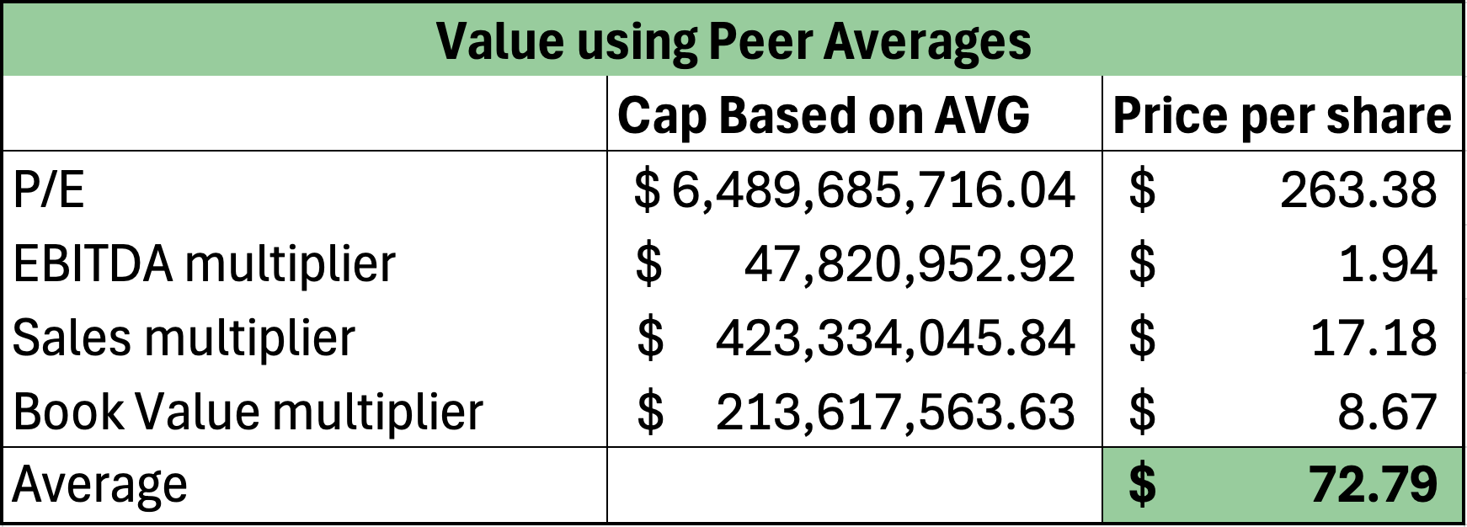
Company Valuation – relative valuation model
A linear regression analysis shows that Nvidia's stock moves with the Nasdaq index but at a higher rate, with a 1% increase in Nasdaq returns leading to a 1.27% increase in Nvidia’s returns.
A relative valuation based on January 2024 peer averages estimates Nvidia’s stock price at $72.79, suggesting it may be undervalued compared to its semiconductor industry peers.
Despite concerns of overvaluation, Nvidia remains a strong investment due to its dominance in AI, with market confidence reflected in its current stock price of $135, driven by expectations of sustained growth and innovation.
Notes:
The 3% is the projected inflation rate for the next year.
Why undervalued? Because in beginning 2024, 2023 had some trouble for the company in that it encountered issues with its latest graphics card at the time, low inventory of products, and the gaming industry not needing the intensity of the newest gpus.
We believe that despite the projected stock price indicating that Nvidia is overvalued, it is still worth investing in stock. Through analysis of the financial, economic, and social factors that surround AI and its integration into society and its applications for the future, we believe that Nvidia will be able to capitalize on this AI market for at least the next 3 years.

Slide 18
Projected Financials – Income Statement
Based on historical growth patterns, we project 30% growth from 2026-2028, tapering to 15% and 10% beyond 2028 as competition increases and market share declines.
Direct Cost expected to remain low for the next three years, then rise to 33% as production scales to meet demand and competition.
R&D expenditure is projected to increase to 15% by 2028 and 20% by 2030.
SGA expenses expected to trend toward the historical rate of 9%.

Slide 19
Projected Financials – Balance Sheet
Cash is projected to stay at the historical average level of 13% as Nvidia keeps its strategy to invest in short-term investments and fixed assets over holding cash.
Accounts receivable is projected to grow from 15% to 20% of total revenue by 2028, but increasing competition is expected to reduce business volume, leading to a decline in subsequent years.
Gross PPE is projected to grow 20% annually, reflecting Nvidia’s AI infrastructure expansion.

Slide 20
Projected Financials – Balance Sheet
Accounts payable & accrued expenses are projected to grow at 5.9% and 5.7% annually, respectively, as Nvidia reinvests earnings.
LT debt expected to increase after 3 years as they seek additional financing to fund their growth.
The D/E is expected to decrease over time as Nvidia relies less on debt to finance product quality improvements, technological advancements, and fixed asset expansion.

Slide 21
Our Recommendation
We recommend holding Nvidia’s stock for the next three years, as we anticipate the company will maintain its market dominance during this period.
However, given the fast-paced innovation in the industry, competitors are expected to catch up, leading to more stabilized returns. At that point, we suggest selling the stock as its growth potential may moderate.
Hold
Notes:
Based on the analyzed data, our investment recommendation for Nvidia, advising investors to hold the shares for the next three years before deciding whether to sell or retain them further, depending on market conditions.
Given the anticipated rise in competition, a long-term holding strategy will allow for potential growth and stability, ensuring an informed decision at the appropriate time.

Slide 22
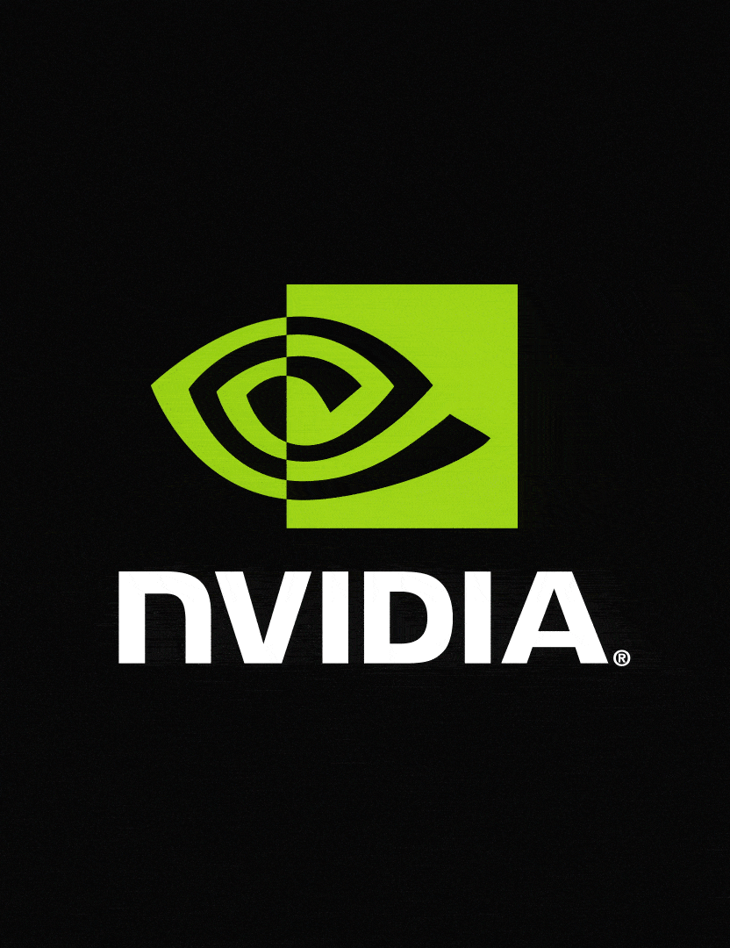
Thank you

